Slide 1
Telescience WG
Shinji Shimojo
Fang-pang Lin

Slide 2
Discussions (since PRAGMA 11)
1. Environment:
a. Common Test Platform:
b. Common Architecture
i. Middleware <led by Tomas Molina> ASK Tomas!!
ii. Viz Wall (TDW) <Framework from Jason Leigh>
iii. Real time video streaming <UW>
2. Applications:
a. General Targets:
i. On demand real-time streaming.
ii. Distributed measurement
iii. Scalable, adaptive, reusable…
b. Applications: Bio-medical, Earthquake, Flood Control,
Meteorological, Agricultural, Ecological, Oceanographic,
GeoScience

Slide 3
3. Possible joint tests (real work & live demo)
PRAGMA 13: Sep 23, 2007 - Sep 26, 2007
SC2007: Nov, 2007
  Resources: <24/7 now>
    Feeds to 24x7 for multiple-stream server (8 streams, 1.5G each)/persistent connection. UW, CALIT2.
    GLEON/CREON testbed <YYL, Trout lake + others, e.g. Erken Lake> (NCHC)
    International Multiple-HDV feeds (All)
    Telescope remote control (Osaka, NCU?)
    Realtime Video Streaming (UW)
  Data visualization
    Fluid Dynamics- 200GB- 2kx4k, 100K steps (Osaka)
    Fruit-fly Brain images (NTHU, NCHC)
  Technology development
    Multiple-data streaming to single TDW
    Collaborative TDWs
  Take home assignment
    Listing your own projects’ architecture or framework in Wiki
    More Tele-science (two-way communication/remote control) (Osaka, UCSD, KBSI) SAKANE
Other:
  NEES is participating.

Slide 4
Update From Pragma 12
Thanks to Prime students
  New Project begins
    Visualize Cardiomyocyte 3D micro-structures in 3MV UHVEM
    Integration of Naregi Datagrid and NCMIR telescience portal begins
  Farther development of TDW
    Deproyment of Covise and development of File browser Plag-in
Introduction of secure access control mechanism in E-science environment
  Permis and GAMA are used for Constructing an easy authentication system and Constructing a control mechanism which can access the appropriate resource (program and data) according to user's role.
  Integrated E-science application will be shown on next SC07
ECOGRID Update
  GLEON 5 SIL 2007, Montreal, Canada (Aug)
  The Research Coordination Network: a 5-year, NSF-funded activity of GLEON that promotes the strategic development of GLEON. (PI: Paul Hanson)
  Sensor Network deployment in Japan
TELEHVEM
  Telescience portal based on Sun Grid Engine
Realtime video streaming

Slide 5
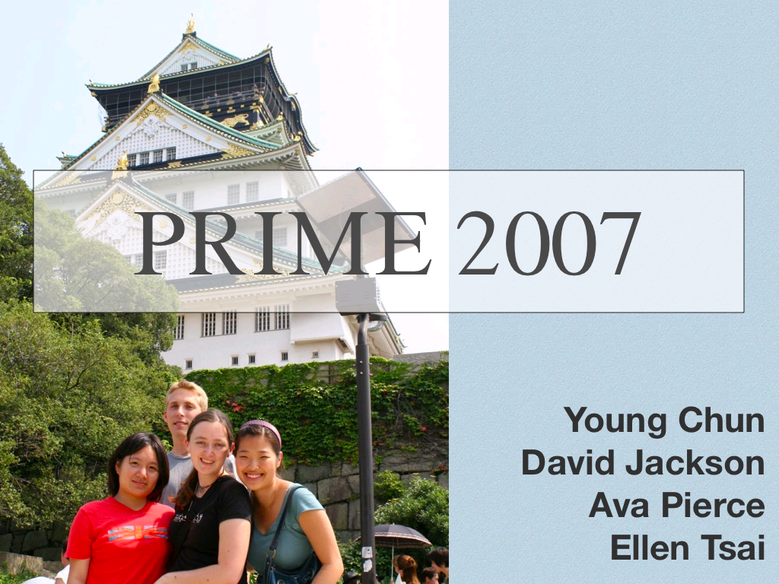

Slide 6
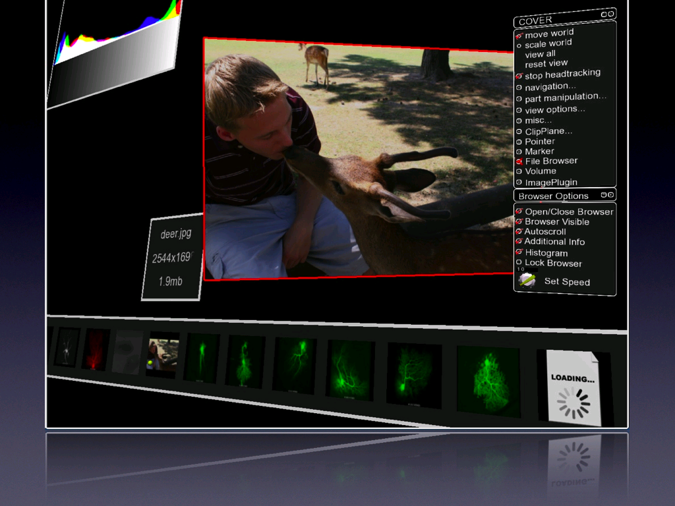

Slide 7
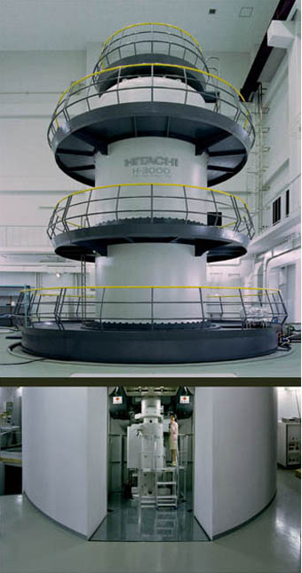
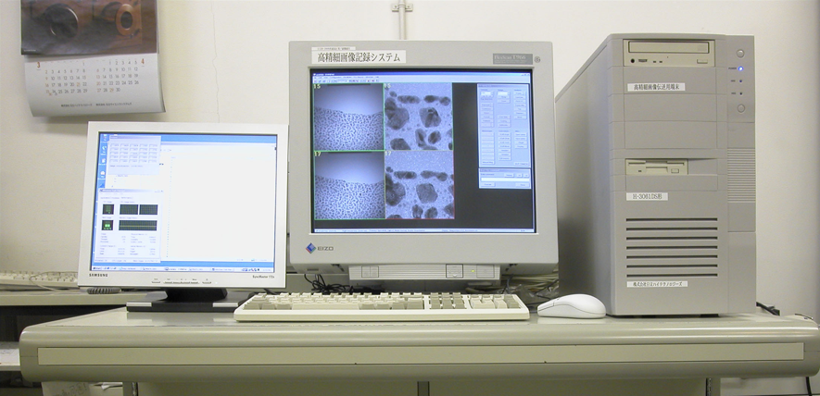


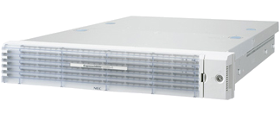


Data flow in the PRIME 2007 project
UHVEM
CCD camera
controller
data
Cybermedia Center
Research Center for Ultra-High Voltage Electron Microscopy
WebDAV/Samba/SCP
Storage
IMOD
WebDAV
data
Cell Centered Database
National Center for Microscopy and Imaging Research
data
data
Courtesy by Young Chun
Notes:
IMOD: a software for tomographic/3D reconstruction.

Slide 8
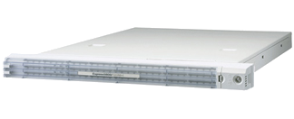
Integration of NAREGI Data Grid
UHVEM
データプロバイダ
CCD camera
controller
VO Centric approach
data
Cybermedia Center
Research Center for Ultra-High Voltage Electron Microscopy
SCP/gfreg (gfarm)
Gfarm
IMOD
SS/IS
data
WebDAV
NAREGI Portal
GridVMs
Tomographic/3D
reconstruction
Cell Centered Database
National Center for Microscopy and Imaging Research
data
data
Notes:
NAREGIデータグリッドにより、撮影イメージを gfarm にインポートし、tomographic/3D reconstruction ジョブを SS から投げられる、という（現時点では）夢物語。

Slide 9
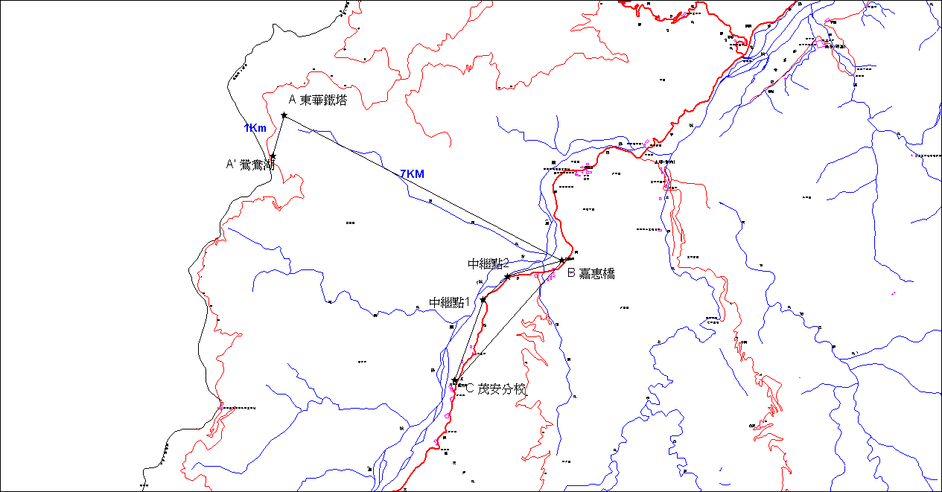
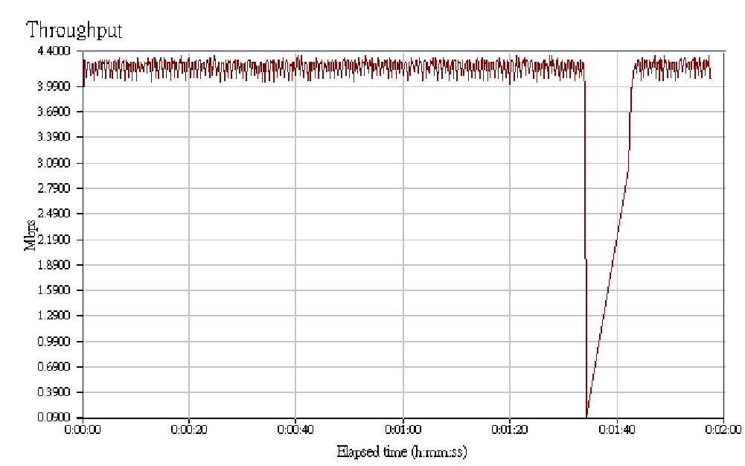
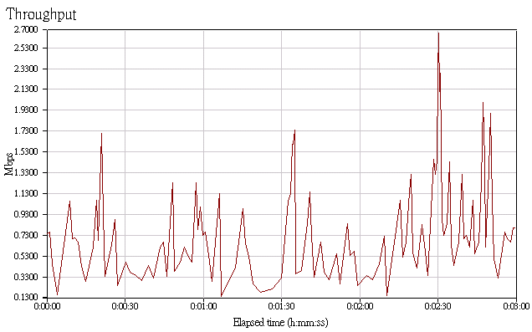
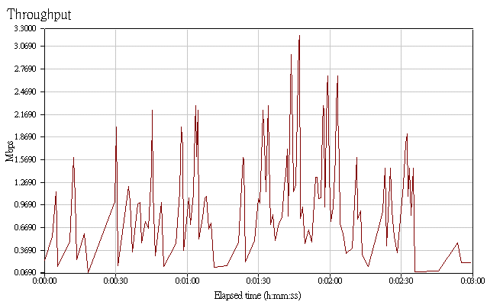
WiMAX Proof-of-Concept Test @ YYL
Proxim MP.11 5054R (Pre-WiMAX)
Proxim MP.16 3500 (WiMAX)
Dong-Hwa Tower
Yuang-Yang Lake
Relay 2
Gia-Huei Bridge
Relay 1
Internet cloud
Digital Opportunity Center,
Mau-An, Skikun Primary School

Slide 10
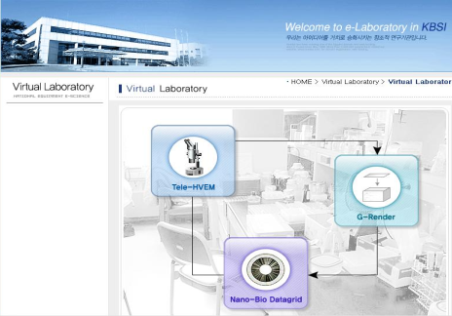

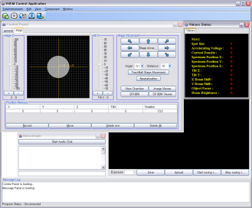
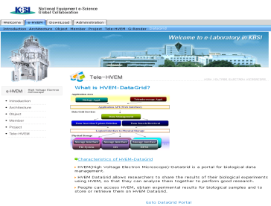
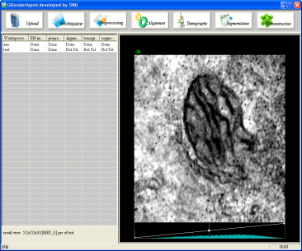
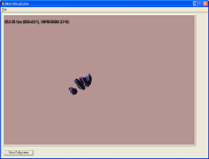
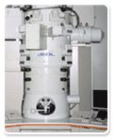



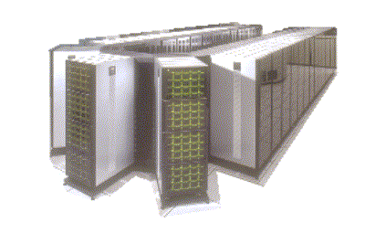
TeleHVEM Project
Virtual Laboratory
SSL –based Security
Remote control
Data management
Image processing
Mgmt
Store
Upload/download
Control
Processing
HVEM
Data Grid
Computational Grid

Slide 11
Presentations
"iHD1500:Low latency multipoint telepresence" Jim DeRoest, Michel
“TDW” Raj Singh
"TeleHVEM" Heon Yeom
“A method of data sharing in 2007 PRIME project and a study of its integration into NAREGI data grid environment.” Eisaku Sakane
“JGN2 project, Osaka University,Japan” Yang
“Ecogrid Update” Phang Pan Lin
“Weather Forecast Application on the Sensor Network” Seiichi Kato
Jung-Hun Woo “air quality monitoring”

Slide 12
Discussion
What we could do in SC07
Common Platform and Archtecture for telescience
  Use of TDW
  Realtime Video Streaming
  Sensor data sharing
We may want to talk with GeoScience WG
And more…

